Slide 1
Graphs & Dijkstra’s Algorithm

Slide 2

Graphs: how can we visualize them?
Each point is represented by a vertex (node)
Edges are drawn by lines between vertices
A Tree is a type of graph
All trees are graphs, but not all graphs are trees

Slide 3
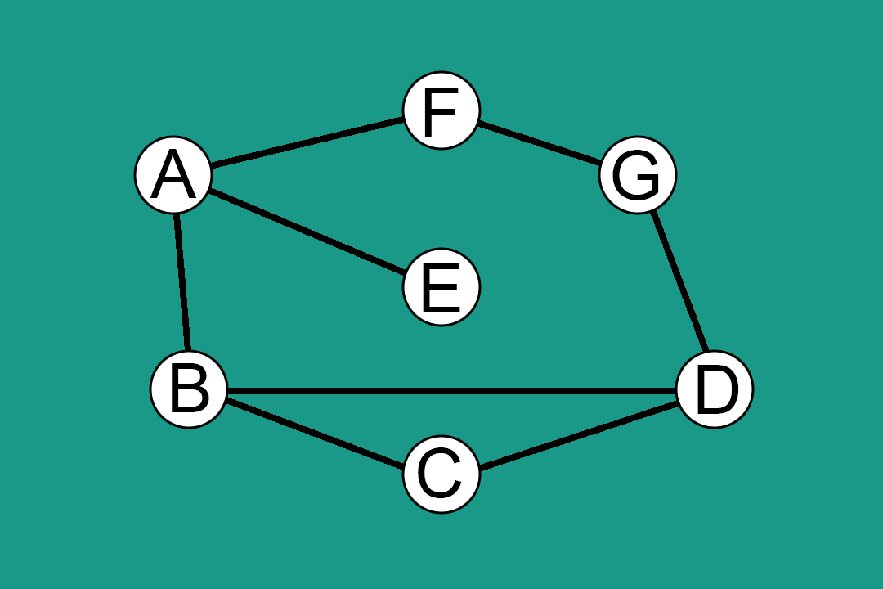

Slide 4
Two major types of graphs
Directed (connecting arrows).
1
Nodes are website pages, edges are possible routes to other pages.
2
Undirected (straight lines).
Social network, nodes are people, edges are friendships.

Slide 5
How are graphs represented in code?
Adjacency List
Incidence Matrix
1
3
Array of nodes, which each store linked lists for a list of edges
2D array with:
N nodes as rows
V edges (vertices) as columns
2
Adjacency Matrix
2D array with (N = # of Nodes)
N rows
N columns
If edge exists, spot in table is 1

Slide 6
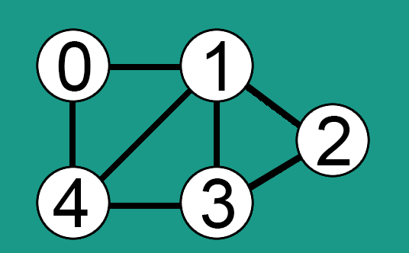
Adjacency List
Associates each vertex with the collection of its neighboring vertices or edges.
In this graph:
Node 0: 1, 4,
Node 1: 0, 4, 3, 2
Node 2: 1, 3
Node 3: 1, 2, 4
Node 4: 0, 1, 3, 4

Slide 7
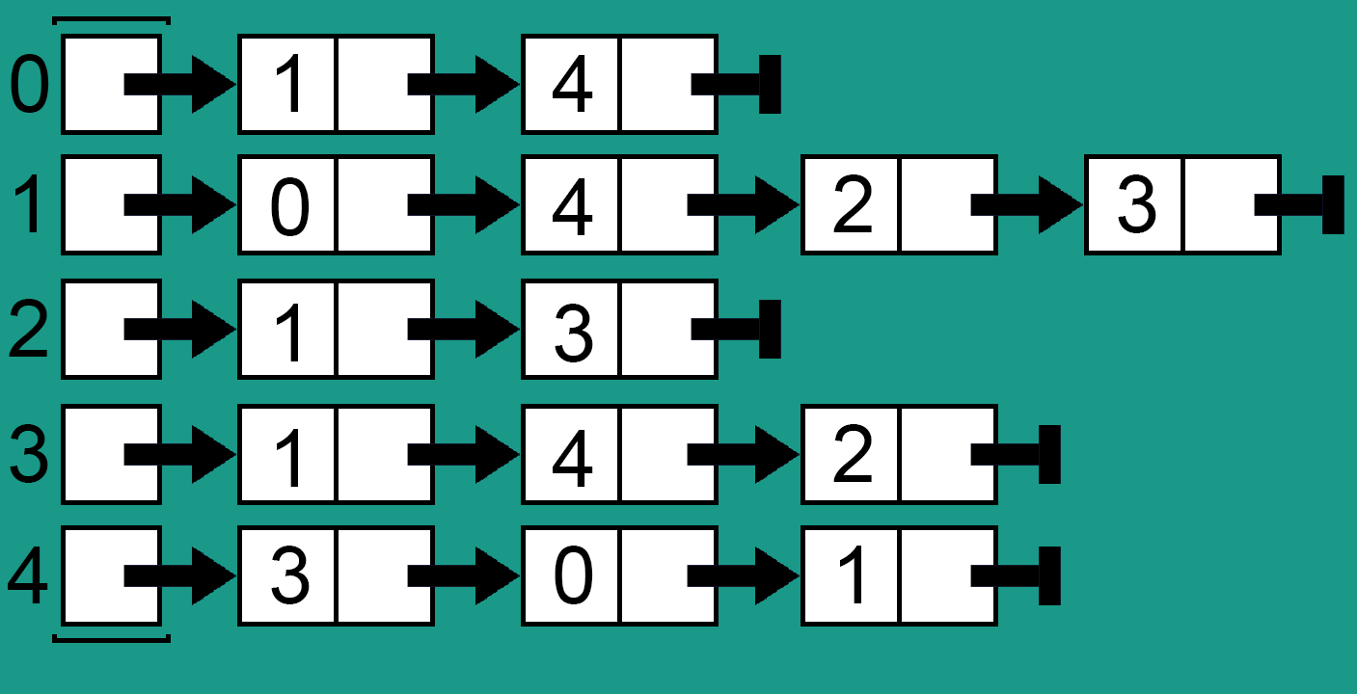
Adjacency List (cont.)
Stored internally as an array of linked lists
Size of the array is equal to the number of vertices.

Slide 8
Pros vs. Cons: Adjacency List
Pros:
Use memory in proportion to the number of edges
Saves memory if there are a ton more vertices than edges
Fast to iterate over all edges
Good if you want to store multiple fields in each vertex / node
Think google maps tracking users, nodes might store geo-data.
Cons:
Slightly slower than an adjacency matrix to check whether or not a specific edge exists.

Slide 9
Adjacency Matrix
2D matrix
Dimensions of 2D array N x N equal to the number of nodes.
Easy to represent directed graphs
Only store an edge in one place(demonstrated in a few slides).

Slide 10
Adjacency Matrix (non-directional)
If there exists an edge from one node to another, store 1
Otherwise, store 0
 | 0 | 1 | 2 | 3 | 4
0 | 0 | 1 | 0 | 0 | 1
1 | 1 | 0 | 1 | 1 | 1
2 | 0 | 1 | 0 | 1 | 0
3 | 0 | 1 | 1 | 0 | 1
4 | 1 | 1 | 0 | 1 | 0

Slide 11
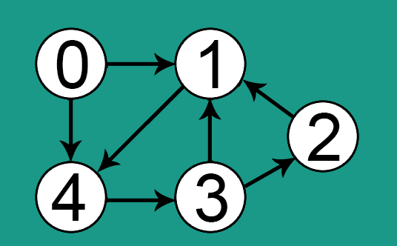
Adjacency Matrix (directional)
How would I represent this as an adjacency matrix?
How would I add weights to these edges easily?

Slide 12
Pros vs. Cons: Adjacency Matrix
Pros:
Fast lookups to see whether an edge exists (and its value if its a directed graph)
If the nodes / vertices don’t have many fields, can be more efficient for space and memory.
Cons:
Uses array of size N*N (V*V) memory
If there are a lot more edges than vertices than edges, there will be a lot of wasted space.
Slow lookups for all edges.

Slide 13
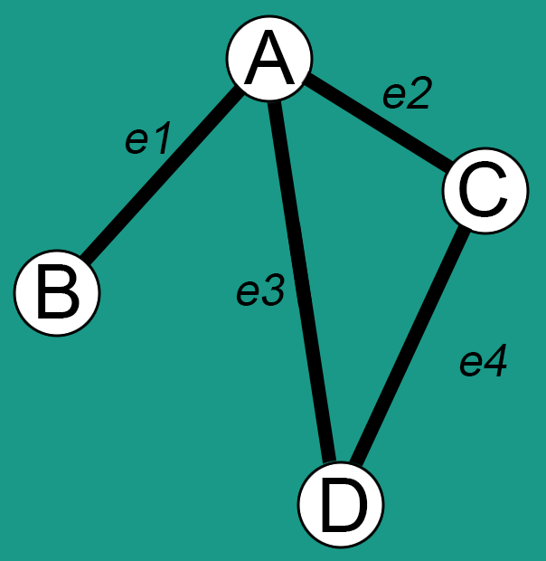
Incidence Matrix
Similar to adjacency matrix, but:
Stores nodes as rows
Stores edges as columns
If a relationship exists between the node and an edge, 1 entry in table
Otherwise, 0
Used mostly for math applications

Slide 14
Incidence Matrix (cont.)
 | e1 | e2 | e3 | e4
A | 1 | 1 | 1 | 0
B | 1 | 0 | 0 | 0
C | 0 | 1 | 0 | 1
D | 0 | 0 | 1 | 1
Stored internally as an array of linked lists
Size of the array is equal to the number of vertices.

Slide 15
Pros vs. Cons: Incidence Matrix
Pros:
Efficient if you have either a large ratio from V:E or E:V.
Low number of rows / columns
Cons:
Slow Lookups of all edges
Not often used in computer science

Slide 16
Graph Cycles
If there is a ‘loop’ in the graph that allows us to visit nodes in a circular pattern, the graph is cyclic
This can occur if the graph is directed or undirected
A common example of a Directed Acyclic Graph (DAG) is a binary tree.
Many of the graphs we looked at so far contained cycles

Slide 17

Dijkstra’s Algorithm

Slide 18
Edsger W. Dijkstra
The art of programming is the art of organizing complexity, of mastering multitude and avoiding its bastard chaos as effectively as possible.

Slide 19

What is it?
01
Algorithm to find the shortest path between nodes in a graph.
Operates on a weighted graph.
Starts with an initial node and a goal node.
Finds the least cost path to the goal node.
Greedy algorithm.

Slide 20
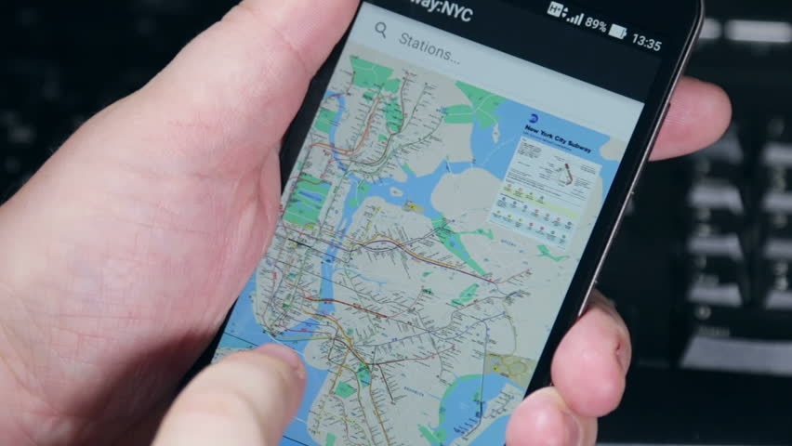
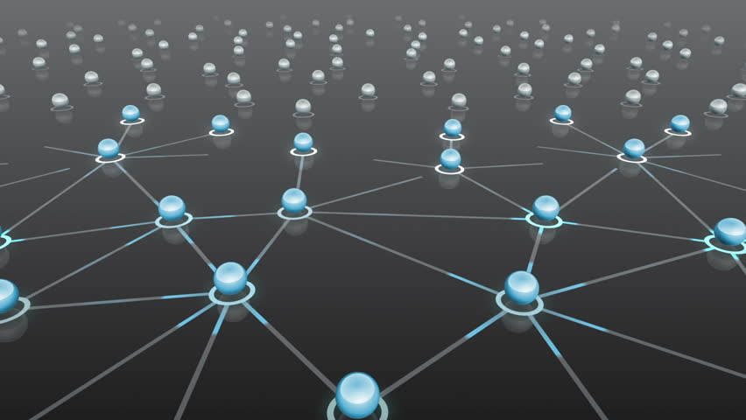

Why do I care?
Routing
Satellite Navigation
Social network relationships
01
03
Utilized in network routing protocols, notably IS-IS (Intermediate System to Intermediate System) and OSPF (Open Shortest Path First). (I.e. what is the best route for given packets?)
02
Travelling from one destination to another, which roads are the fastest?
Users are represented by vertices, and friendships / follows are represented by edges.

Slide 21
Board example
Create a set sptSet (shortest path tree set) that keeps track of vertices included in shortest path tree.
Assign a distance value to all vertices in input graph. Initialize all distance values as (INFINITE). Assign distance value to 0 for source vertex so it is picked first.
3. While sptSet doesn’t include all vertices:
Pick a vertex v which is not in sptSet and has smallest distance value.
Include u to sptSet.
Update distance value of all adjacent vertices of u.

Slide 22
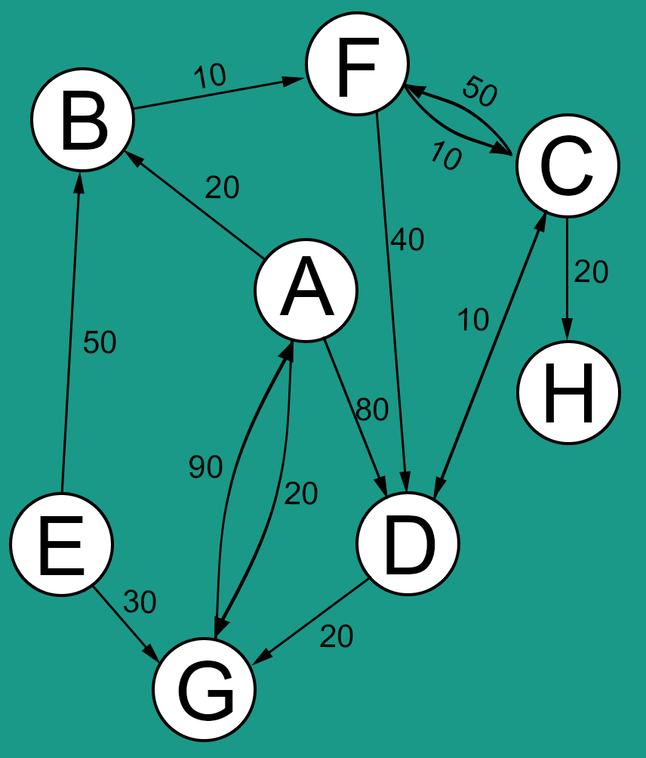

Slide 23
How does it look in java?

Slide 24
Thank you.

